Slide 1

Computer Instructions
Computer Organization and Architecture | Register Organization
Course: Computer Organization and Architecture | Chapter: Register Organization | Bachelor of Engineering
DISCOVER · LEARN · EMPOWER
Notes:
Welcome everyone to today's lecture on Computer Instructions within the Register Organization chapter. We will explore how the CPU interprets and executes commands. This session is designed to help you analyze the instruction set architecture effectively. Remember, mastering this is key to understanding how software interacts with hardware.

Slide 2
Course Outcomes
SLIDE 2 / 10
Course Outcome
CO | BT LEVEL | DESCRIPTION
CO1 | BT3 | Apply number systems and digital logic to design basic digital circuits
CO2 | BT4 | Analyze register organization and instruction set architecture
CO3 | BT3 | Implement computer arithmetic algorithms and floating-point operations
CO4 | BT5 | Analyze memory hierarchy and input-output organization
CO5 | BT6 | Evaluate control unit design and pipelining performance
Chandigarh University
2 / 10
Notes:
Today's lecture directly addresses Course Outcome 2, which requires you to analyze register organization and instruction set architecture. We will focus specifically on how instructions are structured and how they utilize registers. By the end of this session, you should be able to deconstruct an instruction format. This analysis is crucial for designing efficient computer systems.

Slide 3
Learning Objectives
SLIDE 3 / 10
Learning Outcomes
1
Define the fundamental structure of a computer instruction.
2
Analyze the relationship between opcodes and register operands.
3
Evaluate different addressing modes used in instruction execution.
4
Compare the impact of instruction formats on register usage.
5
Apply instruction decoding logic to a sample machine code.
Chandigarh University
3 / 10
Notes:
By the end of this lecture, you will be able to define the fundamental structure of a computer instruction. You will analyze how opcodes interact with register operands to perform operations. We will also evaluate different addressing modes and their impact on register usage. Finally, you will apply decoding logic to a sample machine code example.

Slide 4
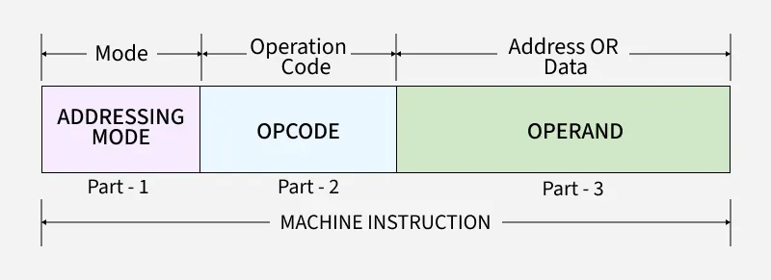
Lecture
SLIDE 4 / 10
Instruction Structure Basics
1
An instruction consists of an opcode and one or more operands.
2
The opcode specifies the operation to be performed by the CPU.
3
Operands specify the data or the address of data to be used.
4
In register organization, operands often refer to specific CPU registers.
5
The instruction length is determined by the number of address fields.
6
A complete instruction must be fetchable and decodable by the control unit.
Instruction Formats - GeeksforGeeks
Chandigarh University
4 / 10
Notes:
Think of an instruction as a command card with two main parts: the opcode and the operand. The opcode tells the CPU what to do, like adding two numbers. The operand tells the CPU where to find the numbers, often in a register. For example, an ADD instruction might specify registers R1 and R2 as operands. Without this structure, the CPU cannot know which data to process.

Slide 5
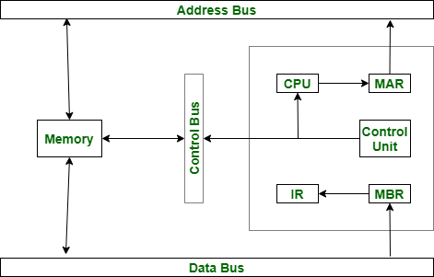
Lecture
SLIDE 5 / 10
Instruction Formats and Registers
1
Three-address instructions use three register operands for maximum flexibility.
2
Two-address instructions use one register and one memory or register operand.
3
One-address instructions use an accumulator register for most operations.
4
Zero-address instructions use a stack register for implicit operand handling.
5
The choice of format directly impacts the number of registers required.
6
Complex register organization often favors two-address or three-address formats.
Essential Registers for Instruction Execution - GeeksforGeeks (source: media.geeksforgeeks.org)
Chandigarh University
5 / 10
Notes:
The format of an instruction dictates how many registers we need in our organization. A three-address instruction like ADD R1, R2, R3 uses three registers, requiring a larger register file. In contrast, a one-address instruction uses an accumulator, reducing register needs but increasing memory access. For instance, adding two numbers in a stack-based system requires no explicit register addresses. Choosing the right format is a trade-off between hardware complexity and code density.

Slide 6
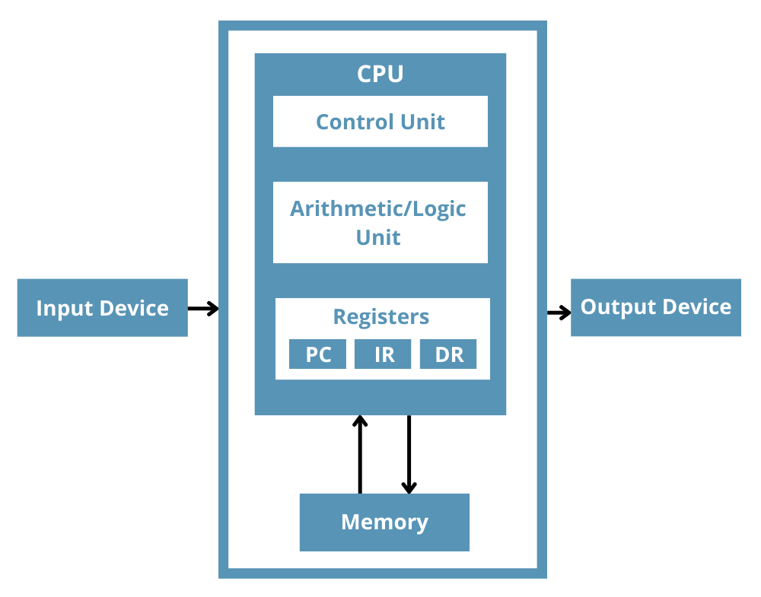
Lecture
SLIDE 6 / 10
Addressing Modes in Instructions
1
Immediate addressing specifies the operand value directly within the instruction.
2
Register addressing specifies the operand location as a register number.
3
Direct addressing specifies the memory address of the operand explicitly.
4
Indirect addressing specifies a register or memory location containing the address.
5
Register indirect addressing uses a register to hold the memory address.
6
The addressing mode determines how the effective address is calculated.
What is a Register in a CPU and How Does it Work? - Total Phase (source: www.totalphase.com)
Chandigarh University
6 / 10
Notes:
Addressing modes define how the CPU finds the data for an instruction. Immediate mode is like writing the number 5 directly in the command. Register mode is like saying 'use the value in register R1'. Direct mode points to a specific memory address. For example, LOAD R1, 1000 means load the value from memory address 1000 into R1. Understanding these modes is essential for analyzing how instructions interact with the register organization.

Slide 7
Lecture
SLIDE 7 / 10
Instruction Execution Cycle
1
The CPU fetches the instruction from memory into the instruction register.
2
The control unit decodes the opcode to determine the required operation.
3
The CPU calculates the effective address if the operand is not immediate.
4
The CPU fetches the operand data from the specified register or memory.
5
The CPU executes the operation using the ALU and register organization.
6
The result is stored back into the destination register or memory.
Essential Registers for Instruction Execution - GeeksforGeeks (source: media.geeksforgeeks.org)
Chandigarh University
7 / 10
Notes:
The execution of an instruction follows a strict cycle: fetch, decode, execute. First, the instruction is fetched from memory into the instruction register. Next, the control unit decodes the opcode to understand the operation. Then, the CPU calculates the effective address and fetches the data. For example, an ADD instruction fetches values from R1 and R2, adds them, and stores the result in R3. This cycle repeats millions of × per second.

Slide 8
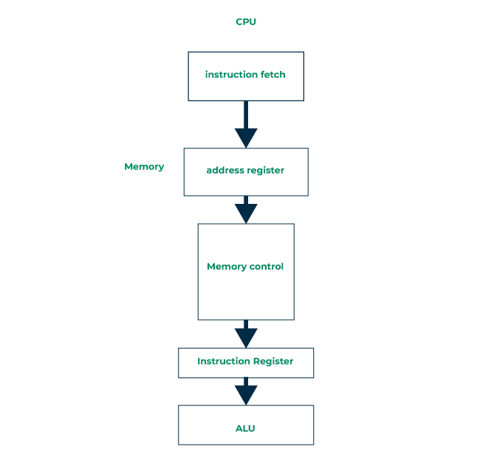
Worked Example
SLIDE 8 / 10
Instruction Analysis
CONSIDER INSTRUCTION
ADD R1, R2, R3 in a three-address format.
EXECUTION
(R1) ← (R2) + (R3) where parentheses denote register contents.
• Opcode 'ADD' specifies the arithmetic addition operation to be performed.
• Operand 1 'R2' and Operand 2 'R3' are source registers containing data.
• Operand 3 'R1' is the destination register for the result.
• This format requires three distinct register references in the instruction word.
Instruction Register - GeeksforGeeks (source: media.geeksforgeeks.org)
Chandigarh University
8 / 10
Notes:
Let's analyze a specific instruction: ADD R1, R2, R3. This is a three-address instruction where the opcode is ADD. The source operands are in registers R2 and R3, and the result is stored in R1. If R2 contains 10 and R3 contains 20, the result 30 is placed in R1. This example shows how the instruction format directly maps to the register organization. It requires the CPU to access three registers simultaneously.

Slide 9
Lecture
SLIDE 9 / 10
Key Takeaways
1
Instructions consist of an opcode and operands defining the operation and data.
2
Instruction formats (3, 2, 1, 0 address) determine register usage and complexity.
3
Addressing modes specify how operands are located in registers or memory.
4
The execution cycle involves fetching, decoding, and executing instructions sequentially.
5
Analyzing instructions requires understanding their impact on the register organization.
What is a Register in a CPU and How Does it Work? - Total Phase (source: www.totalphase.com)
Chandigarh University
9 / 10
Notes:
To summarize, instructions are the bridge between software and hardware register organization. The format of an instruction dictates how many registers are needed and how data is accessed. Addressing modes provide flexibility in locating operands. Remember the execution cycle: fetch, decode, execute. Finally, always analyze how an instruction impacts the register organization when designing or evaluating a system.

Slide 10
Lecture
SLIDE 10 / 10
References
COMPUTER ORGANIZATION AND DESIGN
The Hardware/Software Interface — David A. Patterson, John L. Hennessy
COMPUTER ARCHITECTURE
A Quantitative Approach — John L. Hennessy, David A. Patterson
• Computer Organization and Architecture — William Stallings
• Computer System Architecture — M. Morris Mano & Rajib Mall
• Computer Organization — Carl Hamacher, Zvonko Vranesic, Safwat Zaky
Chandigarh University
10 / 10
Notes:
For further reading, I recommend the textbooks listed on this slide. William Stallings and M. Morris Mano provide excellent foundational knowledge. Carl Hamacher and the works by Patterson and Hennessy offer deeper insights into modern architectures. Please review these references to solidify your understanding of register organization and instruction sets. Thank you for your attention.

